Slide 1
Introduction to Graphs
Graph basics Graph traversal
CSE 221: Algorithms
Introduction to graphs
Mumit Khan
Computer Science and Engineering BRAC University
References
Jon Kleinberg and Éva Tardos, Algorithm Design. Pearson Education, 2006.
T. H. Cormen, C. E. Leiserson, R. L. Rivest, and C. Stein, Introduction to Algorithms, Second Edition. The MIT Press, September 2001.
M. Goodrich and R. Tamassia, Algorithm Design. John-Wiley and Sons. 2002.
Last modified: September 10, 2009
This work is licensed under the Creative Commons Attribution-Noncommercial-Share Alike 3.0 Unported License.
Mumit Khan

Slide 2

Introduction to Graphs
Graph basics Graph traversal
Contents
¹ Introduction to Graphs
Graph basics
Graph traversal
Mumit Khan

Slide 3
Introduction to Graphs
Graph basics Graph traversal
Contents
¹ Introduction to Graphs
Graph basics
Graph traversal
Mumit Khan

Slide 4
Introduction to Graphs
Graph basics Graph traversal
What is a Graph?
Graph G is a pair (V , E ), where V is a finite set (set of vertices) and E is a finite set of pairs from V (set of edges). We will often denote n = |V |, m = |E |.
Graph G can be directed, if E consists of ordered pairs, or undirected, if E consists of unordered pairs. If (u, v ) ∈ E , then vertices u and v are adjacent.
We can assign weight function to the edges: w_{G} (e) is a weight of edge e ∈ E . The graph which has such function assigned is called weighted.
Degree of a vertex v is the number of vertices u for which (u, v ) ∈ E or (v, u) ∈ E (denote deg (v )). The number of incoming edges to a vertex v is called in-degree of the vertex (denote indeg (v )). The number of outgoing edges from a vertex is called out-degree (denote outdeg (v )).
Mumit Khan

Slide 5
Introduction to Graphs
Graph basics Graph traversal
Examples of graphs
Transportation networks How should you design the highway network in a country? What is the quickest way to drive from Badda to Naraynganj?
Communication networks How to send a network packet from Bracu intranet to Yahoo mail server?
Information networks Is the World wide a directed or undirected network?
Social networks Facebook, Myspace, Flickr, . . . .
Dependency networks What courses must you take before you can take cse-423?
Mumit Khan

Slide 6
Introduction to Graphs
Graph basics Graph traversal
Examples of graphs
Transportation networks How should you design the highway network in a country? What is the quickest way to drive from Badda to Naraynganj?
Communication networks How to send a network packet from Bracu intranet to Yahoo mail server?
Information networks Is the World wide a directed or undirected network?
Social networks Facebook, Myspace, Flickr, . . . .
Dependency networks What courses must you take before you can take cse-423?
Mumit Khan
Licensed under
CSE 221: Algorithms
5 / 38

Slide 7
Introduction to Graphs
Graph basics Graph traversal
Examples of graphs
Transportation networks How should you design the highway network in a country? What is the quickest way to drive from Badda to Naraynganj?
Communication networks How to send a network packet from Bracu intranet to Yahoo mail server?
Information networks Is the World wide a directed or undirected network?
Social networks Facebook, Myspace, Flickr, . . . .
Dependency networks What courses must you take before you can take cse-423?
Mumit Khan
Licensed under
CSE 221: Algorithms
5 / 38

Slide 8
Introduction to Graphs
Graph basics Graph traversal
Examples of graphs
Transportation networks How should you design the highway network in a country? What is the quickest way to drive from Badda to Naraynganj?
Communication networks How to send a network packet from Bracu intranet to Yahoo mail server?
Information networks Is the World wide a directed or undirected network?
Social networks Facebook, Myspace, Flickr, . . . .
Dependency networks What courses must you take before you can take cse-423?
Mumit Khan
Licensed under
CSE 221: Algorithms
5 / 38

Slide 9
Introduction to Graphs
Graph basics Graph traversal
Examples of graphs
Transportation networks How should you design the highway network in a country? What is the quickest way to drive from Badda to Naraynganj?
Communication networks How to send a network packet from Bracu intranet to Yahoo mail server?
Information networks Is the World wide a directed or undirected network?
Social networks Facebook, Myspace, Flickr, . . . .
Dependency networks What courses must you take before you can take cse-423?
Mumit Khan

Slide 10
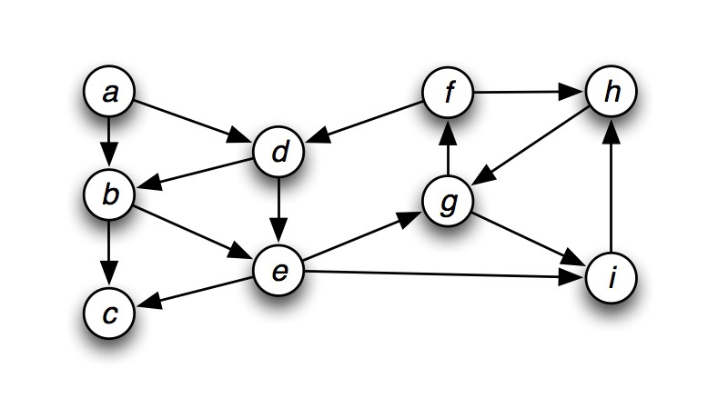
Introduction to Graphs
Graph basics Graph traversal
What is a Graph?
Definition (Graph)
Graph G is a pair (V , E ), where V is a finite set (set of vertices) and E is a finite set of pairs from V (set of edges). We will often denote n = |V |, m = |E |.
Example
Mumit Khan
6 / 38

Slide 11
Introduction to Graphs
Graph basics Graph traversal
What is a Graph?
Definition (Graph)
Graph G is a pair (V , E ), where V is a finite set (set of vertices) and E is a finite set of pairs from V (set of edges). We will often denote n = |V |, m = |E |.
Example
V = {a, . . . , i }, n = 9, m = 15.
Mumit Khan
6 / 38

Slide 12
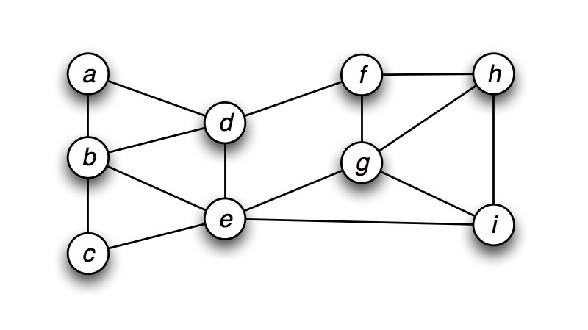
Introduction to Graphs
Graph basics Graph traversal
Directed vs. undirected graphs
Definition (Directed vs. undirected graph)
Graph G can be directed, if E consists of ordered pairs, or undirected, if E consists of unordered pairs. If (u, v ) ∈ E , then vertices u and v are adjacent.
Example
Mumit Khan

Slide 13
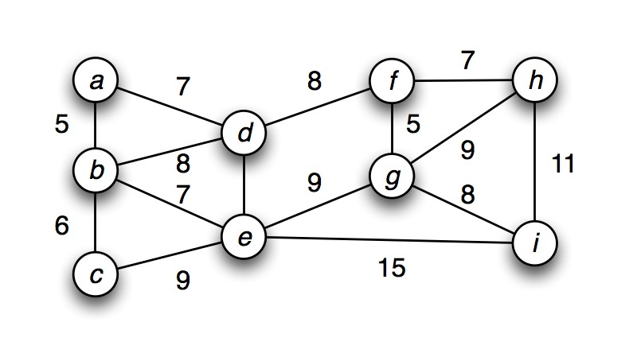
Introduction to Graphs
Graph basics Graph traversal
Weighted graphs
Definition (Weighted graph)
We can assign weight function to the edges: w_{G} (e) is a weight of edge e ∈ E . The graph which has such function assigned is called weighted.
Example
Mumit Khan

Slide 14
Introduction to Graphs
Graph basics Graph traversal
Degree of vertices
Definition (Degree of vertices)
Degree of a vertex v is the number of vertices u for which
(u, v ) ∈ E or (v, u) ∈ E (denote deg (v )). The number of incoming edges to a vertex v is called in-degree of the vertex (denote indeg (v )). The number of outgoing edges from a vertex is called out-degree (denote outdeg (v )).
Example (Directed graph)
Vertex
in out
Mumit Khan
9 / 38

Slide 15
Introduction to Graphs
Graph basics Graph traversal
Degree of vertices
Definition (Degree of vertices)
Degree of a vertex v is the number of vertices u for which
(u, v ) ∈ E or (v, u) ∈ E (denote deg (v )). The number of incoming edges to a vertex v is called in-degree of the vertex (denote indeg (v )). The number of outgoing edges from a vertex is called out-degree (denote outdeg (v )).
Example (Directed graph)
Vertex | in out
a | 0 2
Mumit Khan
9 / 38

Slide 16
Introduction to Graphs
Graph basics Graph traversal
Degree of vertices
Definition (Degree of vertices)
Degree of a vertex v is the number of vertices u for which
(u, v ) ∈ E or (v, u) ∈ E (denote deg (v )). The number of incoming edges to a vertex v is called in-degree of the vertex (denote indeg (v )). The number of outgoing edges from a vertex is called out-degree (denote outdeg (v )).
Example (Directed graph)
Vertex | in out
a | 0 2
b | 2 2
Mumit Khan
9 / 38

Slide 17
Introduction to Graphs
Graph basics Graph traversal
Degree of vertices
Definition (Degree of vertices)
Degree of a vertex v is the number of vertices u for which
(u, v ) ∈ E or (v, u) ∈ E (denote deg (v )). The number of incoming edges to a vertex v is called in-degree of the vertex (denote indeg (v )). The number of outgoing edges from a vertex is called out-degree (denote outdeg (v )).
Example (Directed graph)
Vertex | in out
a | 0 2
b | 2 2
c | 2 0
Mumit Khan
9 / 38

Slide 18
Introduction to Graphs
Graph basics Graph traversal
Degree of vertices
Definition (Degree of vertices)
Degree of a vertex v is the number of vertices u for which
(u, v ) ∈ E or (v, u) ∈ E (denote deg (v )). The number of incoming edges to a vertex v is called in-degree of the vertex (denote indeg (v )). The number of outgoing edges from a vertex is called out-degree (denote outdeg (v )).
Example (Directed graph)
Vertex | in out
a | 0 2
b | 2 2
c | 2 0
d | 2 2
Mumit Khan
9 / 38

Slide 19
Introduction to Graphs
Graph basics Graph traversal
Degree of vertices
Definition (Degree of vertices)
Degree of a vertex v is the number of vertices u for which
(u, v ) ∈ E or (v, u) ∈ E (denote deg (v )). The number of incoming edges to a vertex v is called in-degree of the vertex (denote indeg (v )). The number of outgoing edges from a vertex is called out-degree (denote outdeg (v )).
Example (Directed graph)
Vertex | in out
a | 0 2
b | 2 2
c | 2 0
d | 2 2
e | 2 3
Mumit Khan
9 / 38

Slide 20
Introduction to Graphs
Graph basics Graph traversal
Degree of vertices
Definition (Degree of vertices)
Degree of a vertex v is the number of vertices u for which
(u, v ) ∈ E or (v, u) ∈ E (denote deg (v )). The number of incoming edges to a vertex v is called in-degree of the vertex (denote indeg (v )). The number of outgoing edges from a vertex is called out-degree (denote outdeg (v )).
Example (Undirected graph)
Vertex
deg
Mumit Khan
10 / 38

Slide 21
Introduction to Graphs
Graph basics Graph traversal
Degree of vertices
Definition (Degree of vertices)
Degree of a vertex v is the number of vertices u for which
(u, v ) ∈ E or (v, u) ∈ E (denote deg (v )). The number of incoming edges to a vertex v is called in-degree of the vertex (denote indeg (v )). The number of outgoing edges from a vertex is called out-degree (denote outdeg (v )).
Example (Undirected graph)
Vertex | deg
a | 2
Mumit Khan
10 / 38

Slide 22
Introduction to Graphs
Graph basics Graph traversal
Degree of vertices
Definition (Degree of vertices)
Degree of a vertex v is the number of vertices u for which
(u, v ) ∈ E or (v, u) ∈ E (denote deg (v )). The number of incoming edges to a vertex v is called in-degree of the vertex (denote indeg (v )). The number of outgoing edges from a vertex is called out-degree (denote outdeg (v )).
Example (Undirected graph)
Vertex | deg
a | 2
b | 4
Mumit Khan
10 / 38

Slide 23
Introduction to Graphs
Graph basics Graph traversal
Degree of vertices
Definition (Degree of vertices)
Degree of a vertex v is the number of vertices u for which
(u, v ) ∈ E or (v, u) ∈ E (denote deg (v )). The number of incoming edges to a vertex v is called in-degree of the vertex (denote indeg (v )). The number of outgoing edges from a vertex is called out-degree (denote outdeg (v )).
Example (Undirected graph)
Vertex | deg
a | 2
b | 4
c | 2
Mumit Khan
10 / 38

Slide 24
Introduction to Graphs
Graph basics Graph traversal
Degree of vertices
Definition (Degree of vertices)
Degree of a vertex v is the number of vertices u for which
(u, v ) ∈ E or (v, u) ∈ E (denote deg (v )). The number of incoming edges to a vertex v is called in-degree of the vertex (denote indeg (v )). The number of outgoing edges from a vertex is called out-degree (denote outdeg (v )).
Example (Undirected graph)
Vertex | deg
a | 2
b | 4
c | 2
d | 4
Mumit Khan
10 / 38

Slide 25
Introduction to Graphs
Graph basics Graph traversal
Degree of vertices
Definition (Degree of vertices)
Degree of a vertex v is the number of vertices u for which
(u, v ) ∈ E or (v, u) ∈ E (denote deg (v )). The number of incoming edges to a vertex v is called in-degree of the vertex (denote indeg (v )). The number of outgoing edges from a vertex is called out-degree (denote outdeg (v )).
Example (Undirected graph)
Vertex | deg
a | 2
b | 4
c | 2
d | 4
e | 5
Mumit Khan
10 / 38

Slide 26
Relationship of n = |V | and m = |E |
Introduction to Graphs Graph basics Graph traversal
Theorem
If G is a graph with m edges, then
^{Σ} deg (v ) = 2m.
v ∈G
Mumit Khan
11 / 38

Slide 27
Relationship of n = |V | and m = |E |
Introduction to Graphs Graph basics Graph traversal
Theorem
If G is a graph with m edges, then
^{Σ} deg (v ) = 2m.
v ∈G
Proof.
An edge (u, v ) is counted twice in the above summation; once by its endpoint u and once by its endpoint v . Thus, the total contribution of the edges to the degrees of the vertices is twice the number of edges.
Mumit Khan
11 / 38

Slide 28
Relationship of n = |V | and m = |E |
Introduction to Graphs Graph basics Graph traversal
Theorem
If G is a directed graph (digraph) with m edges, then
^{Σ} indeg (v ) = ^{Σ} outdeg (v ) = m.
v ∈G v ∈G
Mumit Khan
12 / 38

Slide 29
Relationship of n = |V | and m = |E |
Introduction to Graphs Graph basics Graph traversal
Theorem
If G is a directed graph (digraph) with m edges, then
^{Σ} indeg (v ) = ^{Σ} outdeg (v ) = m.
v ∈G v ∈G
Proof.
In a directed graph, an edge (u, v ) contributes one unit to the out-degree of its origin u and one unit to the in-degree of its destination v . Thus, the total contribution of the edges to the out-degrees of the vertices is equal to the number of edges, and similarly for the in-degrees.
Mumit Khan
12 / 38

Slide 30
Relationship of n = |V | and m = |E |
Introduction to Graphs Graph basics Graph traversal
Theorem
If G is a simple undirected graph with n vertices and m edges, then m ≤ n(n − 1)/2.
Mumit Khan
13 / 38

Slide 31
Relationship of n = |V | and m = |E |
Introduction to Graphs Graph basics Graph traversal
Theorem
If G is a simple undirected graph with n vertices and m edges, then m ≤ n(n − 1)/2.
Proof.
Since G is a simple undirected graph without self-loops, the maximum degree of a vertex is n − 1. And, since there are n vertices, and each edge is counted twice (once for each end of an edge (u, v ), the maximum number of edges is n(n − 1)/2. Thus,
m ≤ n(n − 1)/2, or
m = Θ(n²).
Mumit Khan
13 / 38

Slide 32
Relationship of n = |V | and m = |E |
Introduction to Graphs Graph basics Graph traversal
Theorem
If G is a simple directed graph with n vertices and m edges, then m ≤ n(n − 1).
Mumit Khan
14 / 38

Slide 33
Relationship of n = |V | and m = |E |
Introduction to Graphs Graph basics Graph traversal
Theorem
If G is a simple directed graph with n vertices and m edges, then m ≤ n(n − 1).
Proof.
Since G is a simple graph without self-loops, the maximum
in-degree of a vertex is n − 1. And, since there are n vertices, and no two edges can have the same origin and destination,
m ≤ n(n − 1), or
m = Θ(n²).
Mumit Khan
14 / 38

Slide 34
Introduction to Graphs
Graph basics Graph traversal
Paths and connectivity
Definition (Path)
A path in a undirected graph G = (V , E ) is sequence P of vertices v 1, v₂, . . . , v_{k−1}, v_{k} with the property that for i ∈ {1, . . . , k − 1}, (v_{i} , v_{i +1}) ∈ E .
Mumit Khan
15 / 38

Slide 35
Introduction to Graphs
Graph basics Graph traversal
Paths and connectivity
Definition (Path)
A path in a undirected graph G = (V , E ) is sequence P of vertices v 1, v₂, . . . , v_{k−1}, v_{k} with the property that for i ∈ {1, . . . , k − 1}, (v_{i} , v_{i +1}) ∈ E .
Definition (Simple and cyclic paths)
A path is simple if all vertices are distinct. A cycle is a path
v₁, v₂, . . . , v_{k−1}, v_{k} in which k ≥ 2, and the first k − 1 nodes are all distinct, and v₁ = v_{k} .
Mumit Khan
15 / 38

Slide 36
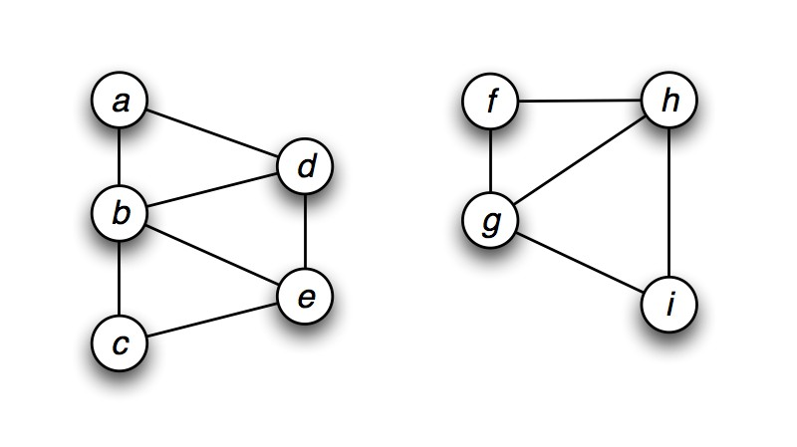
Connected vs. unconnected graphs
Introduction to Graphs Graph basics Graph traversal
Definition (Connected graph)
The undirected graph G is connected, if for every pair of vertices
u, v there exists a path from u to v .
If a graph is not connected, the vertices of the graph can be divided into connected components. Two vertices are in the same connected component iff they are connected by a path.
Example (Connected components)
Mumit Khan
16 / 38

Slide 37
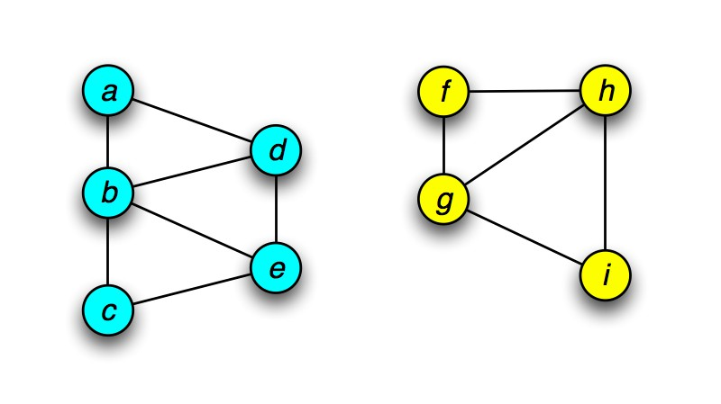
Connected vs. unconnected graphs
Introduction to Graphs Graph basics Graph traversal
Definition (Connected graph)
The undirected graph G is connected, if for every pair of vertices
u, v there exists a path from u to v .
If a graph is not connected, the vertices of the graph can be divided into connected components. Two vertices are in the same connected component iff they are connected by a path.
Example (Connected components)
=⇒
Mumit Khan
16 / 38

Slide 38
Introduction to Graphs
Graph basics Graph traversal
Trees
Definition (Trees)
A undirected graph is a tree if it is connected and does not contain a cycle (implies that every n-node tree has exactly n − 1 edges).
Mumit Khan
17 / 38

Slide 39
Introduction to Graphs
Graph basics Graph traversal
Trees
Definition (Trees)
A undirected graph is a tree if it is connected and does not contain a cycle (implies that every n-node tree has exactly n − 1 edges).
Theorem
For undirected graph G, any two of the following implies the third.
G is connected.
G does not contain a cycle. G has n − 1 edges.
1
2
3
Mumit Khan
17 / 38

Slide 40
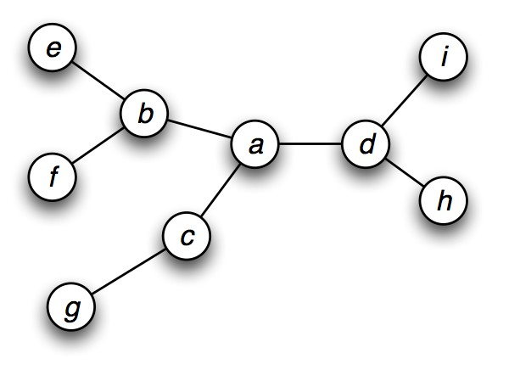
Introduction to Graphs
Graph basics Graph traversal
Trees
Definition (Trees)
A undirected graph is a tree if it is connected and does not contain a cycle (implies that every n-node tree has exactly n − 1 edges).
Theorem
For undirected graph G, any two of the following implies the third.
G is connected.
G does not contain a cycle. G has n − 1 edges.
1
2
3
Example (Trees (or not))
Mumit Khan
17 / 38

Slide 41
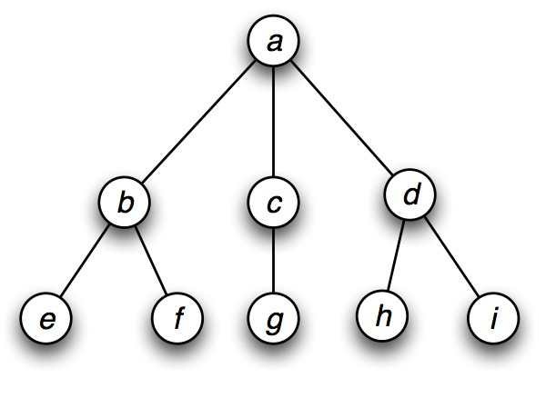
Introduction to Graphs
Graph basics Graph traversal
Trees
Definition (Trees)
A undirected graph is a tree if it is connected and does not contain a cycle (implies that every n-node tree has exactly n − 1 edges).
Theorem
For undirected graph G, any two of the following implies the third.
G is connected.
G does not contain a cycle. G has n − 1 edges.
1
2
3
Example (Trees (or not))
Mumit Khan
17 / 38

Slide 42
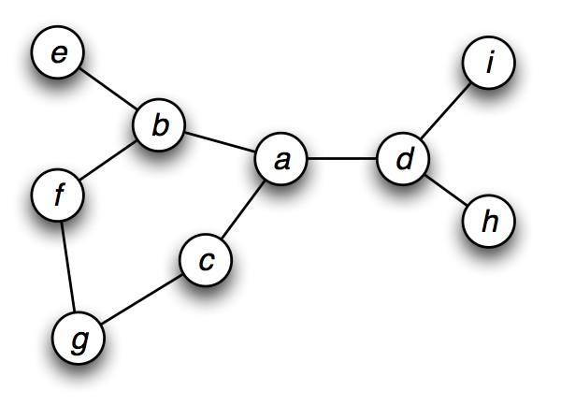
Introduction to Graphs
Graph basics Graph traversal
Trees
Definition (Trees)
A undirected graph is a tree if it is connected and does not contain a cycle (implies that every n-node tree has exactly n − 1 edges).
Theorem
For undirected graph G, any two of the following implies the third.
G is connected.
G does not contain a cycle. G has n − 1 edges.
1
2
3
Example (Trees (or not))
Mumit Khan
17 / 38

Slide 43
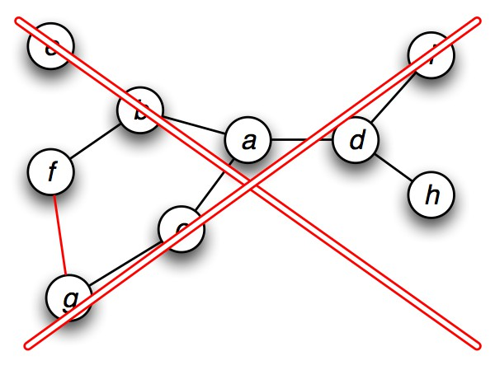
Introduction to Graphs
Graph basics Graph traversal
Trees
Definition (Trees)
A undirected graph is a tree if it is connected and does not contain a cycle (implies that every n-node tree has exactly n − 1 edges).
Theorem
For undirected graph G, any two of the following implies the third.
G is connected.
G does not contain a cycle. G has n − 1 edges.
1
2
3
Example (Trees (or not))
Mumit Khan
17 / 38

Slide 44

Introduction to Graphs
Graph basics Graph traversal
Trees
Definition (Trees)
A undirected graph is a tree if it is connected and does not contain a cycle (implies that every n-node tree has exactly n − 1 edges).
Theorem
For undirected graph G, any two of the following implies the third.
G is connected.
G does not contain a cycle. G has n − 1 edges.
1
2
3
Example (Trees (or not))
Mumit Khan
17 / 38

Slide 45
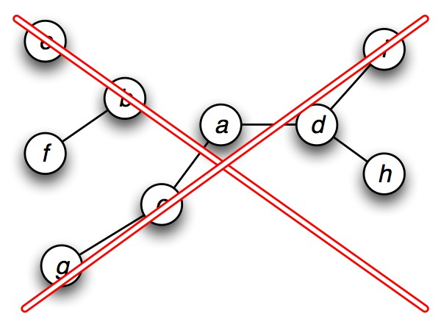
Introduction to Graphs
Graph basics Graph traversal
Trees
Definition (Trees)
A undirected graph is a tree if it is connected and does not contain a cycle (implies that every n-node tree has exactly n − 1 edges).
Theorem
For undirected graph G, any two of the following implies the third.
G is connected.
G does not contain a cycle. G has n − 1 edges.
1
2
3
Example (Trees (or not))
Mumit Khan
17 / 38

Slide 46
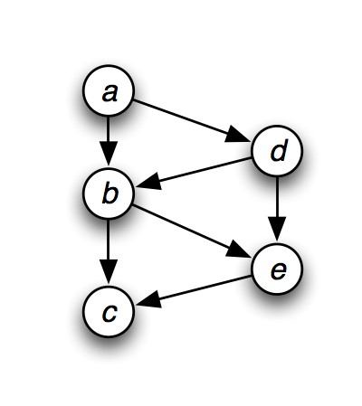
Introduction to Graphs
Graph basics Graph traversal
Representation of graphs
Definition (Adjacency Matrix)
Represents the graph as an n × n matrix A = (a_{i,j} ), where
1, if (v_{i} , v_{j} ) ∈ E , 0, otherwise.
a =
i,j
The matrix is symmetric in case of undirected graph, while it may be asymmetric if the graph is directed.
Example (Directed graph)
a b c d e
a 0 1 0 1 0
b 0 0 1 0 1
c 0 0 0 0 0
d 0 1 0 0 1
e 0 0 1 0 0
Mumit Khan
18 / 38

Slide 47
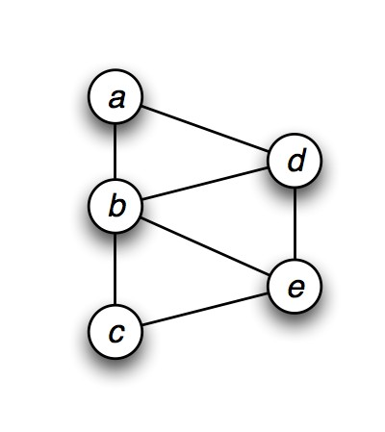
Introduction to Graphs
Graph basics Graph traversal
Representation of graphs
Definition (Adjacency Matrix)
Represents the graph as an n × n matrix A = (a_{i,j} ), where
1, if (v_{i} , v_{j} ) ∈ E , 0, otherwise.
a =
i,j
The matrix is symmetric in case of undirected graph, while it may be asymmetric if the graph is directed.
Example (Undirected graph)
a b c d e
a 0 1 0 1 0
b 1 0 1 1 1
c 0 1 0 0 1
d 1 1 0 0 1
e 0 1 1 1 0
Mumit Khan

Slide 48
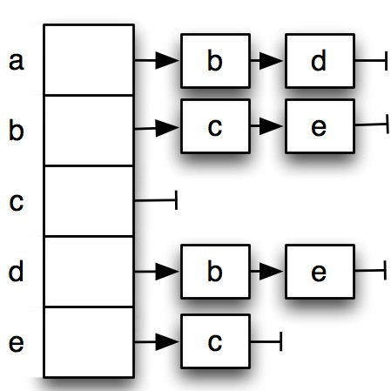
Introduction to Graphs
Graph basics Graph traversal
Representation of graphs
Definition (Adjacency List)
Represent the graph by listing for each vertex v_{i} its outgoing vertices in a list out(v_{i} ). (Representation can be linked list, or another appropriate structure.)
Example (Directed graph)
Mumit Khan
19 / 38

Slide 49
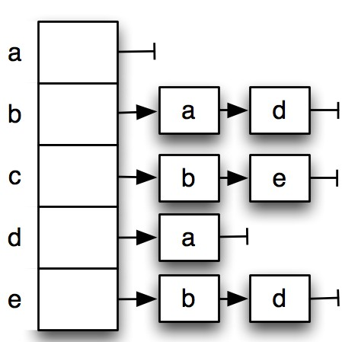
Introduction to Graphs
Graph basics Graph traversal
Representation of graphs
Definition (Adjacency List)
Represent the graph by listing for each vertex v_{i} its outgoing vertices in a list out(v_{i} ). (Representation can be linked list, or another appropriate structure.)
If the graph is directed, it makes sense to build for each vertex v_{i}
also list of its incoming vertices in(v_{i} ).
Example (Directed graph)
Mumit Khan
19 / 38

Slide 50
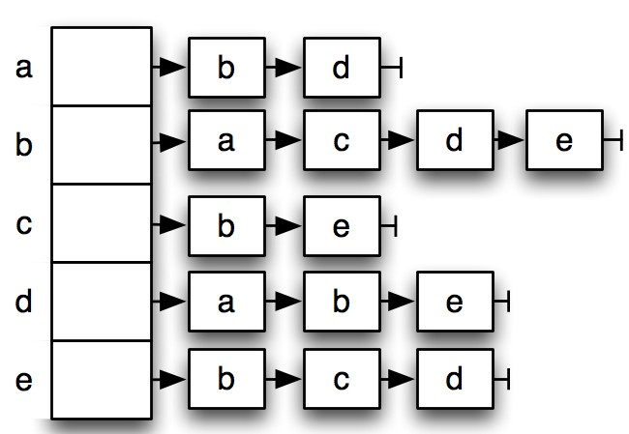
Introduction to Graphs
Graph basics Graph traversal
Representation of graphs
Definition (Adjacency List)
Represent the graph by listing for each vertex v_{i} its outgoing vertices in a list out(v_{i} ). (Representation can be linked list, or another appropriate structure.)
If the graph is undirected, all incident edges are listed for each vertex v_{i} .
Example (Undirected graph)
Mumit Khan
19 / 38

Slide 51
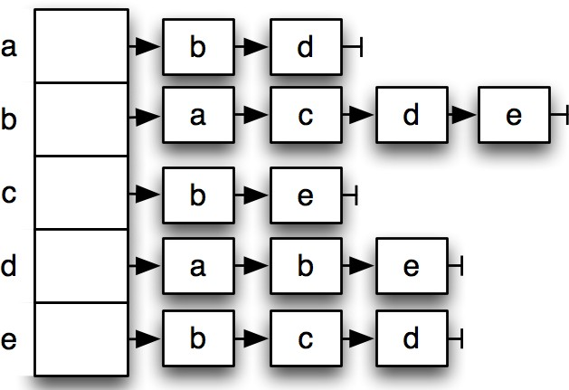
Comparison of graph representations
Introduction to Graphs Graph basics Graph traversal
a b c d e
a 0 1 0 1 0
b 1 0 1 1 1
c 0 1 0 0 1
d 1 1 0 0 1
e 0 1 1 1 0
Operation | Adjacency matrix | Adjacency list
Is (u, v ) ∈ E ? | Θ(1) | Θ(outdeg (u))
List edges outgoing from u | Θ(n) | Θ(outdeg (u))
Memory | Θ(n²) | Θ(m + n)
Mumit Khan
20 / 38

Slide 52
Comparison of graph representations
Introduction to Graphs Graph basics Graph traversal
a b c d e
a 0 1 0 1 0
b 1 0 1 1 1
c 0 1 0 0 1
d 1 1 0 0 1
e 0 1 1 1 0
Operation | Adjacency matrix | Adjacency list
Is (u, v ) ∈ E ? | Θ(1) | Θ(outdeg (u))
List edges outgoing from u | Θ(n) | Θ(outdeg (u))
Memory | Θ(n²) | Θ(m + n)
Representation note
We will be using adjacency lists to represent graphs, unless stated otherwise.
Mumit Khan
20 / 38

Slide 53
Some very basic questions for a graph
Introduction to Graphs Graph basics Graph traversal
1
Starting from a given source vertex, can I reach a target
vertex? s-t connectivity problem.
Mumit Khan
21 / 38

Slide 54
Some very basic questions for a graph
Introduction to Graphs Graph basics Graph traversal
1
Starting from a given source vertex, can I reach a target
vertex? s-t connectivity problem.
Starting from a given source vertex, how can I visit all the other vertices that have a path from it?
2
Mumit Khan
21 / 38

Slide 55
Some very basic questions for a graph
Introduction to Graphs Graph basics Graph traversal
1
Starting from a given source vertex, can I reach a target
vertex? s-t connectivity problem.
Starting from a given source vertex, how can I visit all the other vertices that have a path from it?
Is the graph connected? If not, what are the connected components?
2
3
Mumit Khan
21 / 38

Slide 56
Some very basic questions for a graph
Introduction to Graphs Graph basics Graph traversal
1
Starting from a given source vertex, can I reach a target
vertex? s-t connectivity problem.
Starting from a given source vertex, how can I visit all the other vertices that have a path from it?
Is the graph connected? If not, what are the connected components?
Is there a cycle in this graph?
2
3
4
Mumit Khan
21 / 38

Slide 57
Some very basic questions for a graph
Introduction to Graphs Graph basics Graph traversal
1
Starting from a given source vertex, can I reach a target
vertex? s-t connectivity problem.
Starting from a given source vertex, how can I visit all the other vertices that have a path from it?
Is the graph connected? If not, what are the connected components?
Is there a cycle in this graph?
Given a source vertex in weighted graph, what is the shortest distance to all the other vertices? Single-source shortest path problem.
2
3
4
5
Mumit Khan
21 / 38

Slide 58
Some very basic questions for a graph
Introduction to Graphs Graph basics Graph traversal
1
Starting from a given source vertex, can I reach a target
vertex? s-t connectivity problem.
Starting from a given source vertex, how can I visit all the other vertices that have a path from it?
Is the graph connected? If not, what are the connected components?
Is there a cycle in this graph?
Given a source vertex in weighted graph, what is the shortest distance to all the other vertices? Single-source shortest path problem.
How to compute the minimum spanning tree?
2
3
4
5
6
Mumit Khan
21 / 38

Slide 59
Introduction to Graphs
Graph basics Graph traversal
Contents
¹ Introduction to Graphs Graph basics
Graph traversal
Mumit Khan

Slide 60
Introduction to Graphs
Graph basics Graph traversal
Graph traversal techniques
The graph traversal problem
Given a graph G = (V , E ), and a distinguished vertex s, how do you visit each vertex v ∈ V exactly once.
Mumit Khan
23 / 38

Slide 61
Introduction to Graphs
Graph basics Graph traversal
Graph traversal techniques
The graph traversal problem
Given a graph G = (V , E ), and a distinguished vertex s, how do you visit each vertex v ∈ V exactly once.
Breadth-first search (BFS)
Depth-first search (DFS)
Start with the source vertex, and fan out from there.
Finds the distance (in terms of edges) of each node from the source.
Start with the source vertex, recursively visit each neighbor, only backtracking when choices are exhausted.
Remember pre-order tree traversal?
Mumit Khan
23 / 38

Slide 62
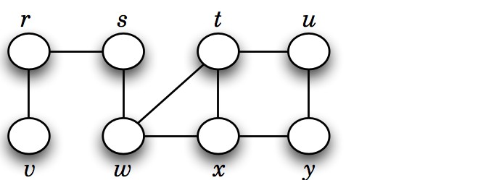
Basic idea behind breadth first search (BFS)
Introduction to Graphs Graph basics Graph traversal
Given a undirected graph G = (V , E ), and a distinguished vertex
s, systematically visit each vertex v ∈ V that is reachable from s.
Mumit Khan

Slide 63
Introduction to Graphs
Graph basics Graph traversal
Breadth first search (BFS)
BFS(G, s) D G = (V , E )
1 Q ← {s}
2 d [v ] ← ∞, ∀v ∈ V ; d [s] ← 0
3 while Q /= Ø
4
5
6
7
8
do u ← dequeue(Q)
for each v ∈ Adj [u]
do if d [v ] = ∞
then d [v ] = d [u] + 1
enqeueue(Q, v )
Mumit Khan
25 / 38

Slide 64
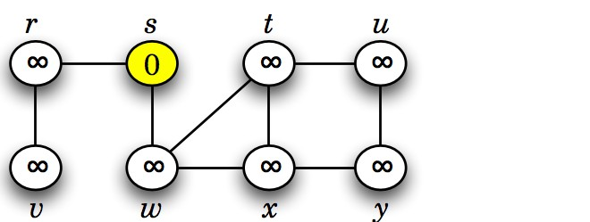
Introduction to Graphs
Graph basics Graph traversal
Breadth first search (BFS)
BFS(G, s) D G = (V , E )
1 Q ← {s}
2 d [v ] ← ∞, ∀v ∈ V ; d [s] ← 0
3 while Q /= Ø
4
5
6
7
8
do u ← dequeue(Q)
for each v ∈ Adj [u]
do if d [v ] = ∞
then d [v ] = d [u] + 1
enqeueue(Q, v )
Mumit Khan
25 / 38

Slide 65
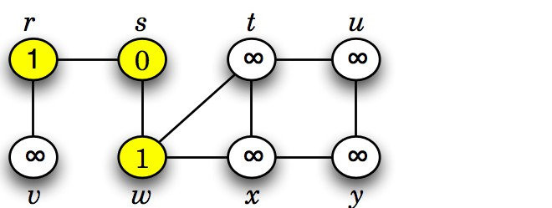
Introduction to Graphs
Graph basics Graph traversal
Breadth first search (BFS)
BFS(G, s) D G = (V , E )
1 Q ← {s}
2 d [v ] ← ∞, ∀v ∈ V ; d [s] ← 0
3 while Q /= Ø
4
5
6
7
8
do u ← dequeue(Q)
for each v ∈ Adj [u]
do if d [v ] = ∞
then d [v ] = d [u] + 1
enqeueue(Q, v )
Mumit Khan
25 / 38

Slide 66
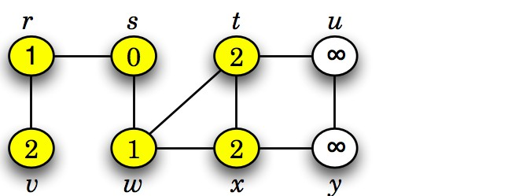
Introduction to Graphs
Graph basics Graph traversal
Breadth first search (BFS)
BFS(G, s) D G = (V , E )
1 Q ← {s}
2 d [v ] ← ∞, ∀v ∈ V ; d [s] ← 0
3 while Q /= Ø
4
5
6
7
8
do u ← dequeue(Q)
for each v ∈ Adj [u]
do if d [v ] = ∞
then d [v ] = d [u] + 1
enqeueue(Q, v )
Mumit Khan
25 / 38

Slide 67
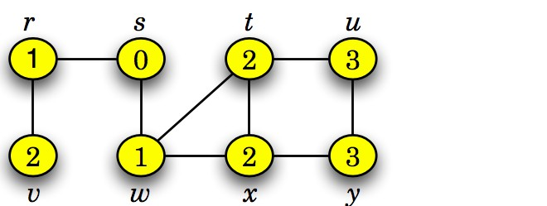
Introduction to Graphs
Graph basics Graph traversal
Breadth first search (BFS)
BFS(G, s) D G = (V , E )
1 Q ← {s}
2 d [v ] ← ∞, ∀v ∈ V ; d [s] ← 0
3 while Q /= Ø
4
5
6
7
8
do u ← dequeue(Q)
for each v ∈ Adj [u]
do if d [v ] = ∞
then d [v ] = d [u] + 1
enqeueue(Q, v )
Mumit Khan
25 / 38

Slide 68
Introduction to Graphs
Graph basics Graph traversal
Breadth first search (BFS)
BFS(G, s) D G = (V , E )
1 Q ← {s}
2 d [v ] ← ∞, ∀v ∈ V ; d [s] ← 0
3 while Q /= Ø
4
5
6
7
8
do u ← dequeue(Q)
for each v ∈ Adj [u]
do if d [v ] = ∞
then d [v ] = d [u] + 1
enqeueue(Q, v )
Analysis
Time = O(V + E ).
Mumit Khan
25 / 38

Slide 69
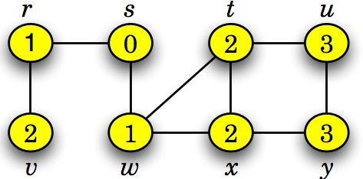
What does this BFS(G, s) algorithm tell us?
Introduction to Graphs Graph basics Graph traversal
This graph G = (V , E ) is connected since BFS visits all vertices v ∈ V starting from s.
Mumit Khan
26 / 38

Slide 70
What does this BFS(G, s) algorithm tell us?
Introduction to Graphs Graph basics Graph traversal
This graph G = (V , E ) is connected since BFS visits all vertices v ∈ V starting from s.
The minimum number of hops or edges between s and any vertex t ∈ V .
Mumit Khan
26 / 38

Slide 71
What does this BFS(G, s) algorithm not tell us?
Introduction to Graphs Graph basics Graph traversal
Is there a cycle in this graph?
Mumit Khan
27 / 38

Slide 72
What does this BFS(G, s) algorithm not tell us?
Introduction to Graphs Graph basics Graph traversal
Is there a cycle in this graph?
Given a target vertex t ∈ V , what is the path with smallest number of edges back to s?
Mumit Khan
27 / 38

Slide 73
What does this BFS(G, s) algorithm not tell us?
Introduction to Graphs Graph basics Graph traversal
Is there a cycle in this graph?
Given a target vertex t ∈ V , what is the path with smallest number of edges back to s?
If this were not a connected graph, how to visit all the vertices?
Mumit Khan
27 / 38

Slide 74
What does this BFS(G, s) algorithm not tell us?
Introduction to Graphs Graph basics Graph traversal
Is there a cycle in this graph?
Given a target vertex t ∈ V , what is the path with smallest number of edges back to s?
If this were not a connected graph, how to visit all the vertices?
Equivalently, how to compute all the connected components of a graph?
Mumit Khan
27 / 38

Slide 75
Computing connected components
Introduction to Graphs Graph basics Graph traversal
Idea
Since each node is visited no more than once (d [v ] /= ∞ after the first visit), simply apply the DFS algorithm over each vertex
v ∈ V , creating a new component each time a vertex is found for which d [v ] = ∞.
Mumit Khan
28 / 38

Slide 76
Computing connected components
Introduction to Graphs Graph basics Graph traversal
Idea
Since each node is visited no more than once (d [v ] /= ∞ after the first visit), simply apply the DFS algorithm over each vertex
v ∈ V , creating a new component each time a vertex is found for which d [v ] = ∞.
BFS(G ) D G = (V , E )
1 d [v ] ← ∞, ∀v ∈ V
2 for each v ∈ V
3
4
do if d [v ] = ∞
then BFS(G, v )
Mumit Khan
28 / 38

Slide 77
A better Breadth first search (BFS) algorithm
Introduction to Graphs Graph basics Graph traversal
Information during traversal
1
color [v ]: the color of each vertex visited
Mumit Khan
29 / 38

Slide 78
A better Breadth first search (BFS) algorithm
Introduction to Graphs Graph basics Graph traversal
Information during traversal
color [v ]: the color of each vertex visited
white: undiscovered
1
Mumit Khan
29 / 38

Slide 79
A better Breadth first search (BFS) algorithm
Introduction to Graphs Graph basics Graph traversal
Information during traversal
color [v ]: the color of each vertex visited
white: undiscovered
gray: discovered but not finished processing
1
Mumit Khan
29 / 38

Slide 80
A better Breadth first search (BFS) algorithm
Introduction to Graphs Graph basics Graph traversal
Information during traversal
color [v ]: the color of each vertex visited
white: undiscovered
gray: discovered but not finished processing black: finished processing
1
Mumit Khan
29 / 38

Slide 81
A better Breadth first search (BFS) algorithm
Introduction to Graphs Graph basics Graph traversal
Information during traversal
color [v ]: the color of each vertex visited
white: undiscovered
gray: discovered but not finished processing black: finished processing
π[v ]: the predecessor pointer
1
2
Mumit Khan
29 / 38

Slide 82
A better Breadth first search (BFS) algorithm
Introduction to Graphs Graph basics Graph traversal
Information during traversal
color [v ]: the color of each vertex visited
white: undiscovered
gray: discovered but not finished processing black: finished processing
π[v ]: the predecessor pointer
d [v ]: the discovery time (or hops from the start)
1
2
3
Mumit Khan
29 / 38

Slide 83
A better Breadth first search (BFS) algorithm
Introduction to Graphs Graph basics Graph traversal
Information during traversal
color [v ]: the color of each vertex visited
white: undiscovered
gray: discovered but not finished processing black: finished processing
π[v ]: the predecessor pointer
d [v ]: the discovery time (or hops from the start)
1
2
3
bfs(G ) ¢ G = (V , E )
¢ Initialize the vertex colors and predecessors
for each vertex v ∈ V
do color [v ] = white
π[v ] = null
for each vertex v ∈ V
5
6
do if color [v ] = white
then BFS(G, v )
Mumit Khan
29 / 38

Slide 84
A better Breadth first search (BFS) algorithm
Introduction to Graphs Graph basics Graph traversal
BFS(G, s) D G = (V , E )
color [s] = gray; π[s] = null; d [s] = 0
Q = ∅; Enqueue(Q, s)
Mumit Khan
30 / 38

Slide 85
A better Breadth first search (BFS) algorithm
Introduction to Graphs Graph basics Graph traversal
BFS(G, s) D G = (V , E )
color [s] = gray; π[s] = null; d [s] = 0
Q = ∅; Enqueue(Q, s)
while Q /= ∅
do u = Dequeue(Q)
for each vertex v ∈ Adj [u]
do if color [v ] = white
then color [v ] = gray
8 d [v ] = d [u] + 1
π[v ] = u
Enqueue(Q, v )
color [u] = black
Mumit Khan
30 / 38

Slide 86
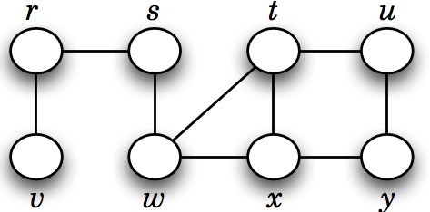
Introduction to Graphs
Graph basics Graph traversal
Application of BFS
Mumit Khan
31 / 38

Slide 87
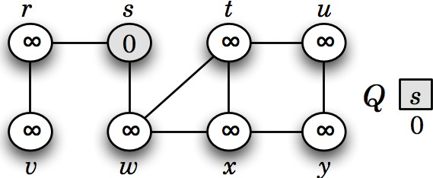
Introduction to Graphs
Graph basics Graph traversal
Application of BFS
Mumit Khan
31 / 38

Slide 88
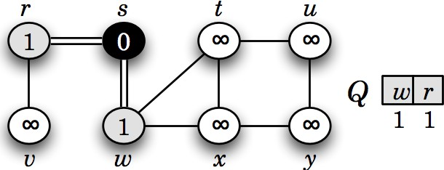
Introduction to Graphs
Graph basics Graph traversal
Application of BFS
Mumit Khan
31 / 38

Slide 89
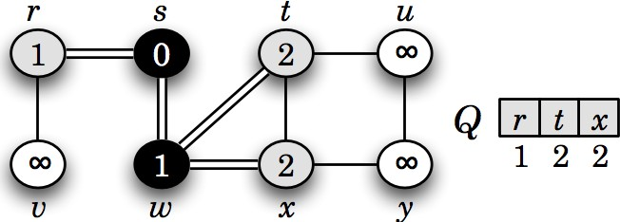
Introduction to Graphs
Graph basics Graph traversal
Application of BFS
Mumit Khan
31 / 38

Slide 90
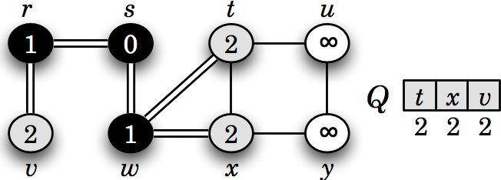
Introduction to Graphs
Graph basics Graph traversal
Application of BFS
Mumit Khan
31 / 38

Slide 91
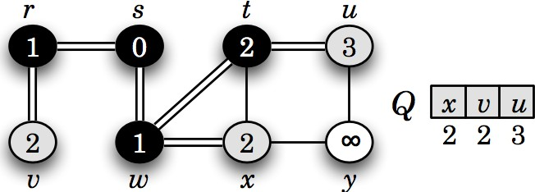
Introduction to Graphs
Graph basics Graph traversal
Application of BFS
Mumit Khan
31 / 38

Slide 92
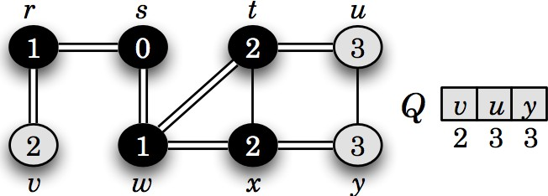
Introduction to Graphs
Graph basics Graph traversal
Application of BFS
Mumit Khan
31 / 38

Slide 93
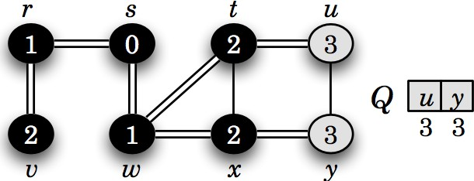
Introduction to Graphs
Graph basics Graph traversal
Application of BFS
Mumit Khan
31 / 38

Slide 94
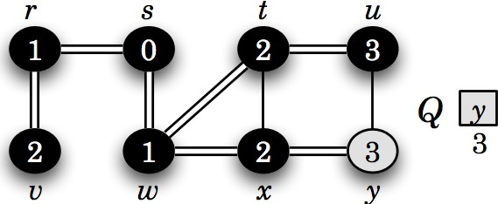
Introduction to Graphs
Graph basics Graph traversal
Application of BFS
Mumit Khan
31 / 38

Slide 95
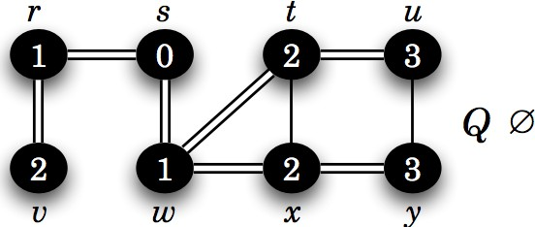
Introduction to Graphs
Graph basics Graph traversal
Application of BFS
Mumit Khan
31 / 38

Slide 96
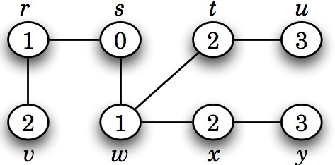
Introduction to Graphs
Graph basics Graph traversal
Application of BFS
Mumit Khan
31 / 38

Slide 97
Introduction to Graphs
Graph basics Graph traversal
Application of BFS
Mumit Khan
32 / 38

Slide 98
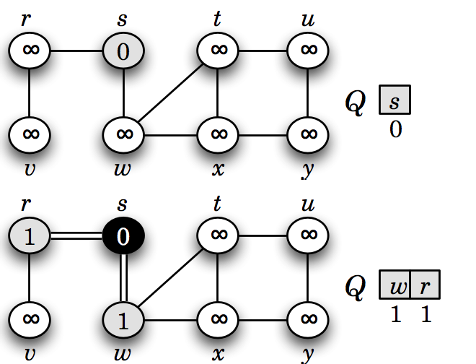
Introduction to Graphs
Graph basics Graph traversal
Application of BFS
Mumit Khan
32 / 38

Slide 99
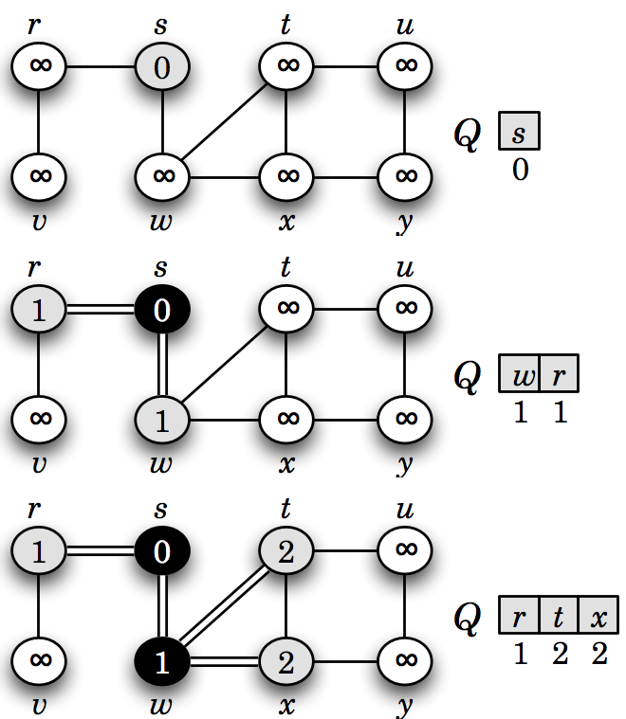
Introduction to Graphs
Graph basics Graph traversal
Application of BFS
Mumit Khan
32 / 38

Slide 100
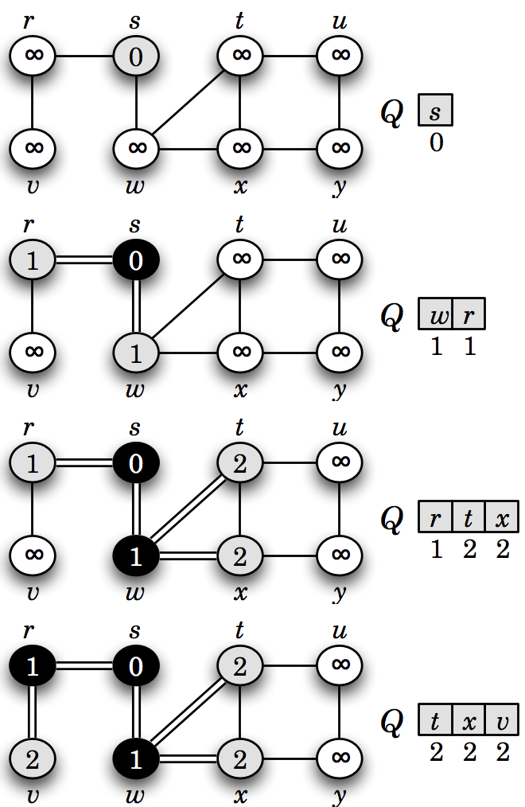
Introduction to Graphs
Graph basics Graph traversal
Application of BFS
Mumit Khan
32 / 38

Slide 101
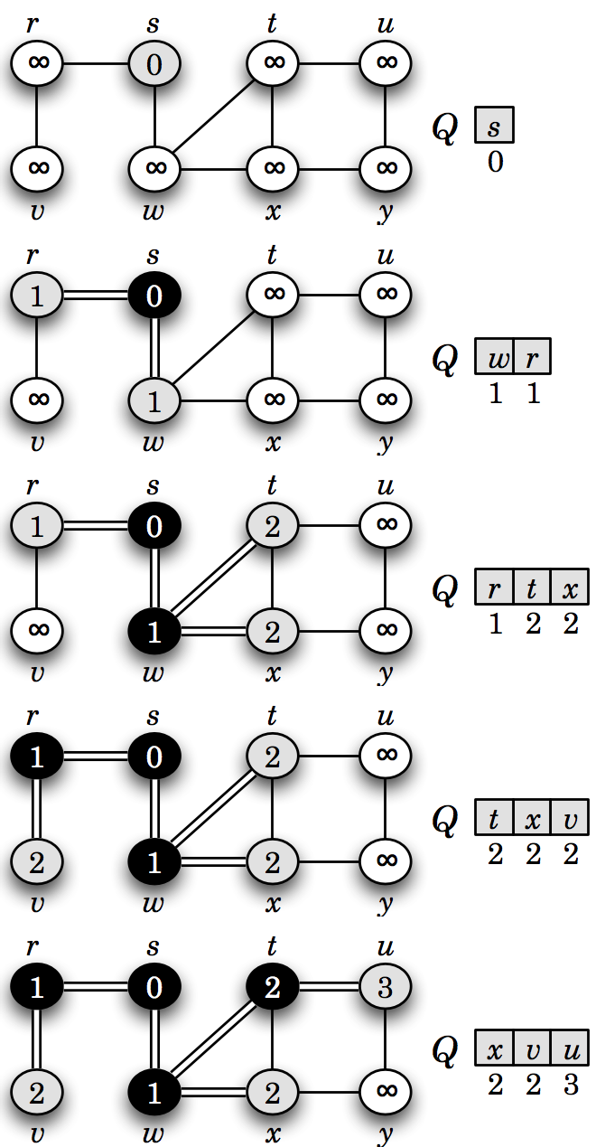
Introduction to Graphs
Graph basics Graph traversal
Application of BFS
Mumit Khan
32 / 38

Slide 102
Introduction to Graphs
Graph basics Graph traversal
Application of BFS
Mumit Khan
32 / 38

Slide 103
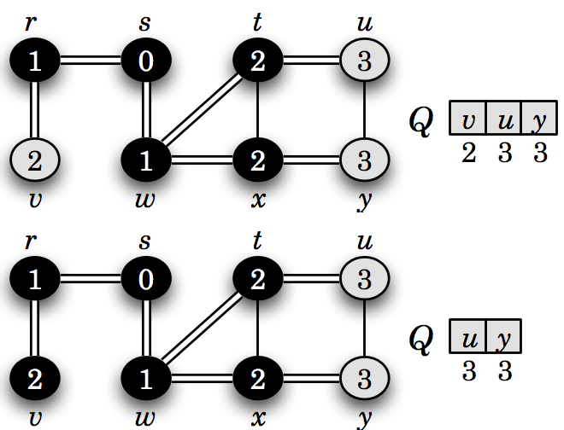
Introduction to Graphs
Graph basics Graph traversal
Application of BFS
Mumit Khan
32 / 38

Slide 104
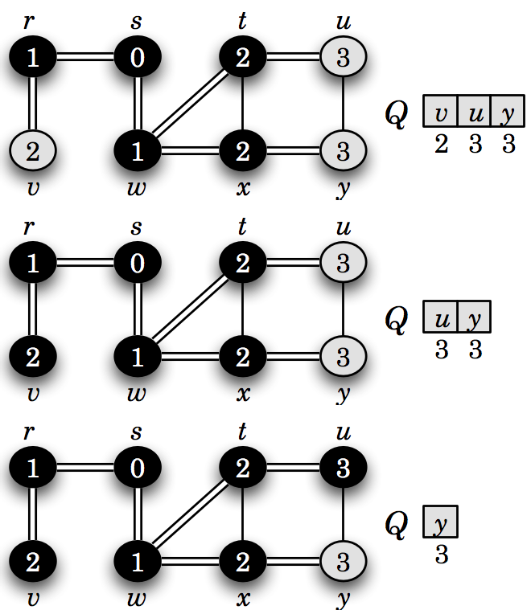
Introduction to Graphs
Graph basics Graph traversal
Application of BFS
Mumit Khan
32 / 38

Slide 105
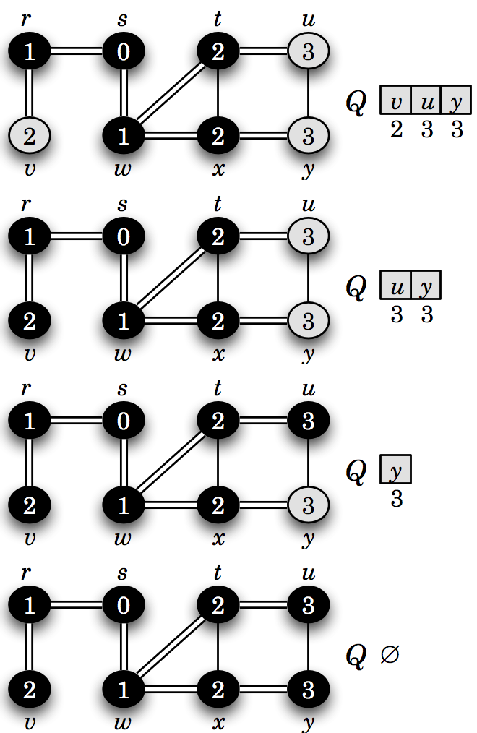
Introduction to Graphs
Graph basics Graph traversal
Application of BFS
Mumit Khan
32 / 38

Slide 106
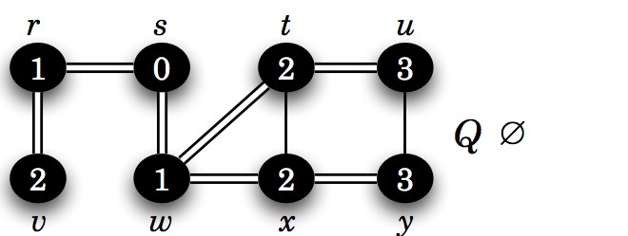
Introduction to Graphs Graph basics Graph traversal
Breadth first search (BFS) tree
¨

Mumit Khan
33 / 38

Slide 107
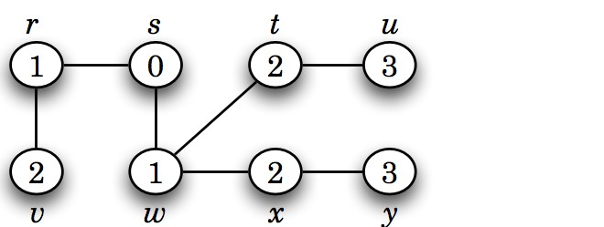
Introduction to Graphs Graph basics Graph traversal
Breadth first search (BFS) tree
¨

Mumit Khan
33 / 38

Slide 108
Depth first search (DFS)
Introduction to Graphs Graph basics Graph traversal
Starts from an initial vertex. Recursively visits each adjacent vertex.
Strategy to search deeper into the graph, unlike BFS which fans out.
Mumit Khan
34 / 38

Slide 109
Depth first search (DFS)
Introduction to Graphs Graph basics Graph traversal
Starts from an initial vertex. Recursively visits each adjacent vertex.
Strategy to search deeper into the graph, unlike BFS which fans out.
Information during traversal
1
color [v ]: the color of each vertex visited
Mumit Khan
34 / 38

Slide 110
Depth first search (DFS)
Introduction to Graphs Graph basics Graph traversal
Starts from an initial vertex. Recursively visits each adjacent vertex.
Strategy to search deeper into the graph, unlike BFS which fans out.
Information during traversal
1
color [v ]: the color of each vertex visited
white: undiscovered
Mumit Khan
34 / 38

Slide 111
Depth first search (DFS)
Introduction to Graphs Graph basics Graph traversal
Starts from an initial vertex. Recursively visits each adjacent vertex.
Strategy to search deeper into the graph, unlike BFS which fans out.
Information during traversal
1
color [v ]: the color of each vertex visited
white: undiscovered
gray: discovered but not finished processing
Mumit Khan
34 / 38

Slide 112
Depth first search (DFS)
Introduction to Graphs Graph basics Graph traversal
Starts from an initial vertex. Recursively visits each adjacent vertex.
Strategy to search deeper into the graph, unlike BFS which fans out.
Information during traversal
1
color [v ]: the color of each vertex visited
white: undiscovered
gray: discovered but not finished processing black: finished processing
Mumit Khan
34 / 38

Slide 113
Depth first search (DFS)
Introduction to Graphs Graph basics Graph traversal
Starts from an initial vertex. Recursively visits each adjacent vertex.
Strategy to search deeper into the graph, unlike BFS which fans out.
Information during traversal
1
color [v ]: the color of each vertex visited
white: undiscovered
gray: discovered but not finished processing black: finished processing
π[v ]: the predecessor pointer
2
Mumit Khan
34 / 38

Slide 114
Depth first search (DFS)
Introduction to Graphs Graph basics Graph traversal
Starts from an initial vertex. Recursively visits each adjacent vertex.
Strategy to search deeper into the graph, unlike BFS which fans out.
Information during traversal
1
color [v ]: the color of each vertex visited
white: undiscovered
gray: discovered but not finished processing black: finished processing
π[v ]: the predecessor pointer
d [v ]: the discovery time (or hops from the start)
2
3
Mumit Khan
34 / 38

Slide 115
Depth first search (DFS)
Introduction to Graphs Graph basics Graph traversal
Starts from an initial vertex. Recursively visits each adjacent vertex.
Strategy to search deeper into the graph, unlike BFS which fans out.
Information during traversal
1
color [v ]: the color of each vertex visited
white: undiscovered
gray: discovered but not finished processing black: finished processing
π[v ]: the predecessor pointer
d [v ]: the discovery time (or hops from the start)
f [v ]: the finish time – when processing of v and all its descendants have finished.
2
3
4
Mumit Khan
34 / 38

Slide 116
Introduction to Graphs
Graph basics Graph traversal
DFS algorithm
DFS(G ) ¢ G = (V , E )
1 for each vertex u ∈ V [G ]
2
3
do color [u] ← white
π[u] ← nil
time ← 0
for each vertex u ∈ V [G ]
6
7
do if color [u] = white
then dfs-visit(u)
DFS-visit(G, u) ¢ G = (V , E ), u ∈ V
color [u] ← gray
time ← time +1
d [u] ← time
for each vertex v ∈ Adj [u]
do if color [v ] = white
then π[v ] ← u
DFS-visit(v )
color [u] ← black
f [u] ← time +1
Mumit Khan
35 / 38

Slide 117
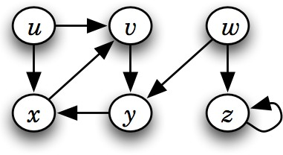
Introduction to Graphs
Graph basics Graph traversal
Application of DFS
DFS(G ) ¢ G = (V , E )
1 for each vertex u ∈ V [G ]
2
do color [u] ← white
3
π[u] ← nil
time ← 0
for each vertex u ∈ V [G ]
6
7
do if color [u] = white
then dfs-visit(u)
DFS-visit(G, u)
color [u] ← gray
time ← time +1
d [u] ← time
for each vertex v ∈ Adj [u]
do if color [v ] = white
then π[v ] ← u
DFS-visit(v )
color [u] ← black
f [u] ← time +1
Mumit Khan Licensed under
CSE 221: Algorithms
36 / 38

Slide 118
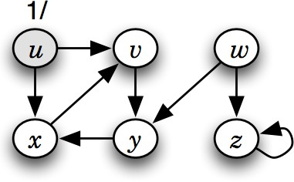
Introduction to Graphs
Graph basics Graph traversal
Application of DFS
DFS(G ) ¢ G = (V , E )
1 for each vertex u ∈ V [G ]
2
do color [u] ← white
3
π[u] ← nil
time ← 0
for each vertex u ∈ V [G ]
6
7
do if color [u] = white
then dfs-visit(u)
DFS-visit(G, u)
color [u] ← gray
time ← time +1
d [u] ← time
for each vertex v ∈ Adj [u]
do if color [v ] = white
then π[v ] ← u
DFS-visit(v )
color [u] ← black
f [u] ← time +1
Mumit Khan Licensed under
CSE 221: Algorithms
36 / 38

Slide 119
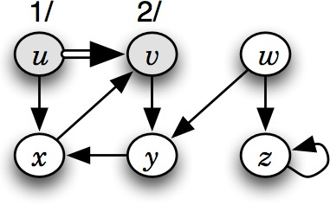
Introduction to Graphs
Graph basics Graph traversal
Application of DFS
DFS(G ) ¢ G = (V , E )
1 for each vertex u ∈ V [G ]
2
do color [u] ← white
3
π[u] ← nil
time ← 0
for each vertex u ∈ V [G ]
6
7
do if color [u] = white
then dfs-visit(u)
DFS-visit(G, u)
color [u] ← gray
time ← time +1
d [u] ← time
for each vertex v ∈ Adj [u]
do if color [v ] = white
then π[v ] ← u
DFS-visit(v )
color [u] ← black
f [u] ← time +1
Mumit Khan Licensed under
CSE 221: Algorithms
36 / 38

Slide 120
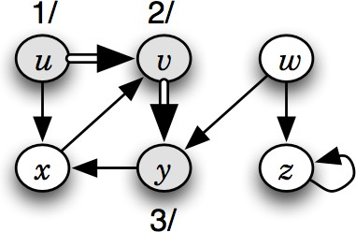
Introduction to Graphs
Graph basics Graph traversal
Application of DFS
DFS(G ) ¢ G = (V , E )
1 for each vertex u ∈ V [G ]
2
do color [u] ← white
3
π[u] ← nil
time ← 0
for each vertex u ∈ V [G ]
6
7
do if color [u] = white
then dfs-visit(u)
DFS-visit(G, u)
color [u] ← gray
time ← time +1
d [u] ← time
for each vertex v ∈ Adj [u]
do if color [v ] = white
then π[v ] ← u
DFS-visit(v )
color [u] ← black
f [u] ← time +1
Mumit Khan Licensed under
CSE 221: Algorithms
36 / 38

Slide 121
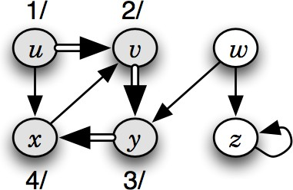
Introduction to Graphs
Graph basics Graph traversal
Application of DFS
DFS(G ) ¢ G = (V , E )
1 for each vertex u ∈ V [G ]
2
do color [u] ← white
3
π[u] ← nil
time ← 0
for each vertex u ∈ V [G ]
6
7
do if color [u] = white
then dfs-visit(u)
DFS-visit(G, u)
color [u] ← gray
time ← time +1
d [u] ← time
for each vertex v ∈ Adj [u]
do if color [v ] = white
then π[v ] ← u
DFS-visit(v )
color [u] ← black
f [u] ← time +1
Mumit Khan Licensed under
CSE 221: Algorithms
36 / 38

Slide 122
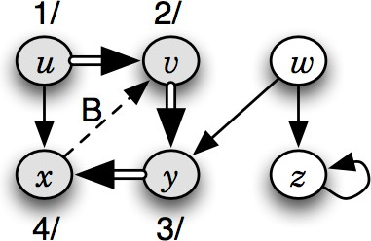
Introduction to Graphs
Graph basics Graph traversal
Application of DFS
DFS(G ) ¢ G = (V , E )
1 for each vertex u ∈ V [G ]
2
do color [u] ← white
3
π[u] ← nil
time ← 0
for each vertex u ∈ V [G ]
6
7
do if color [u] = white
then dfs-visit(u)
DFS-visit(G, u)
color [u] ← gray
time ← time +1
d [u] ← time
for each vertex v ∈ Adj [u]
do if color [v ] = white
then π[v ] ← u
DFS-visit(v )
color [u] ← black
f [u] ← time +1
Mumit Khan Licensed under
CSE 221: Algorithms
36 / 38

Slide 123
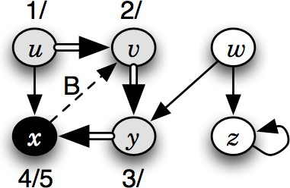
Introduction to Graphs
Graph basics Graph traversal
Application of DFS
DFS(G ) ¢ G = (V , E )
1 for each vertex u ∈ V [G ]
2
do color [u] ← white
3
π[u] ← nil
time ← 0
for each vertex u ∈ V [G ]
6
7
do if color [u] = white
then dfs-visit(u)
DFS-visit(G, u)
color [u] ← gray
time ← time +1
d [u] ← time
for each vertex v ∈ Adj [u]
do if color [v ] = white
then π[v ] ← u
DFS-visit(v )
color [u] ← black
f [u] ← time +1
Mumit Khan Licensed under
CSE 221: Algorithms
36 / 38

Slide 124
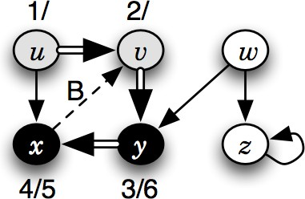
Introduction to Graphs
Graph basics Graph traversal
Application of DFS
DFS(G ) ¢ G = (V , E )
1 for each vertex u ∈ V [G ]
2
do color [u] ← white
3
π[u] ← nil
time ← 0
for each vertex u ∈ V [G ]
6
7
do if color [u] = white
then dfs-visit(u)
DFS-visit(G, u)
color [u] ← gray
time ← time +1
d [u] ← time
for each vertex v ∈ Adj [u]
do if color [v ] = white
then π[v ] ← u
DFS-visit(v )
color [u] ← black
f [u] ← time +1
Mumit Khan Licensed under
CSE 221: Algorithms
36 / 38

Slide 125

Introduction to Graphs
Graph basics Graph traversal
Application of DFS
DFS(G ) ¢ G = (V , E )
1 for each vertex u ∈ V [G ]
2
do color [u] ← white
3
π[u] ← nil
time ← 0
for each vertex u ∈ V [G ]
6
7
do if color [u] = white
then dfs-visit(u)
DFS-visit(G, u)
color [u] ← gray
time ← time +1
d [u] ← time
for each vertex v ∈ Adj [u]
do if color [v ] = white
then π[v ] ← u
DFS-visit(v )
color [u] ← black
f [u] ← time +1
Mumit Khan Licensed under
CSE 221: Algorithms
36 / 38

Slide 126

Introduction to Graphs
Graph basics Graph traversal
Application of DFS
DFS(G ) ¢ G = (V , E )
1 for each vertex u ∈ V [G ]
2
do color [u] ← white
3
π[u] ← nil
time ← 0
for each vertex u ∈ V [G ]
6
7
do if color [u] = white
then dfs-visit(u)
DFS-visit(G, u)
color [u] ← gray
time ← time +1
d [u] ← time
for each vertex v ∈ Adj [u]
do if color [v ] = white
then π[v ] ← u
DFS-visit(v )
color [u] ← black
f [u] ← time +1
Mumit Khan Licensed under
CSE 221: Algorithms
36 / 38

Slide 127

Introduction to Graphs
Graph basics Graph traversal
Application of DFS
DFS(G ) ¢ G = (V , E )
1 for each vertex u ∈ V [G ]
2
do color [u] ← white
3
π[u] ← nil
time ← 0
for each vertex u ∈ V [G ]
6
7
do if color [u] = white
then dfs-visit(u)
DFS-visit(G, u)
color [u] ← gray
time ← time +1
d [u] ← time
for each vertex v ∈ Adj [u]
do if color [v ] = white
then π[v ] ← u
DFS-visit(v )
color [u] ← black
f [u] ← time +1
Mumit Khan Licensed under
CSE 221: Algorithms
36 / 38

Slide 128

Introduction to Graphs
Graph basics Graph traversal
Application of DFS
DFS(G ) ¢ G = (V , E )
1 for each vertex u ∈ V [G ]
2
do color [u] ← white
3
π[u] ← nil
time ← 0
for each vertex u ∈ V [G ]
6
7
do if color [u] = white
then dfs-visit(u)
DFS-visit(G, u)
color [u] ← gray
time ← time +1
d [u] ← time
for each vertex v ∈ Adj [u]
do if color [v ] = white
then π[v ] ← u
DFS-visit(v )
color [u] ← black
f [u] ← time +1
Mumit Khan Licensed under
CSE 221: Algorithms
36 / 38

Slide 129

Introduction to Graphs
Graph basics Graph traversal
Application of DFS
DFS(G ) ¢ G = (V , E )
1 for each vertex u ∈ V [G ]
2
do color [u] ← white
3
π[u] ← nil
time ← 0
for each vertex u ∈ V [G ]
6
7
do if color [u] = white
then dfs-visit(u)
DFS-visit(G, u)
color [u] ← gray
time ← time +1
d [u] ← time
for each vertex v ∈ Adj [u]
do if color [v ] = white
then π[v ] ← u
DFS-visit(v )
color [u] ← black
f [u] ← time +1
Mumit Khan Licensed under
CSE 221: Algorithms
36 / 38

Slide 130

Introduction to Graphs
Graph basics Graph traversal
Application of DFS
DFS(G ) ¢ G = (V , E )
1 for each vertex u ∈ V [G ]
2
do color [u] ← white
3
π[u] ← nil
time ← 0
for each vertex u ∈ V [G ]
6
7
do if color [u] = white
then dfs-visit(u)
DFS-visit(G, u)
color [u] ← gray
time ← time +1
d [u] ← time
for each vertex v ∈ Adj [u]
do if color [v ] = white
then π[v ] ← u
DFS-visit(v )
color [u] ← black
f [u] ← time +1
Mumit Khan Licensed under
CSE 221: Algorithms
36 / 38

Slide 131

Introduction to Graphs
Graph basics Graph traversal
Application of DFS
DFS(G ) ¢ G = (V , E )
1 for each vertex u ∈ V [G ]
2
do color [u] ← white
3
π[u] ← nil
time ← 0
for each vertex u ∈ V [G ]
6
7
do if color [u] = white
then dfs-visit(u)
DFS-visit(G, u)
color [u] ← gray
time ← time +1
d [u] ← time
for each vertex v ∈ Adj [u]
do if color [v ] = white
then π[v ] ← u
DFS-visit(v )
color [u] ← black
f [u] ← time +1
Mumit Khan Licensed under
CSE 221: Algorithms
36 / 38

Slide 132

Introduction to Graphs
Graph basics Graph traversal
Application of DFS
DFS(G ) ¢ G = (V , E )
1 for each vertex u ∈ V [G ]
2
do color [u] ← white
3
π[u] ← nil
time ← 0
for each vertex u ∈ V [G ]
6
7
do if color [u] = white
then dfs-visit(u)
DFS-visit(G, u)
color [u] ← gray
time ← time +1
d [u] ← time
for each vertex v ∈ Adj [u]
do if color [v ] = white
then π[v ] ← u
DFS-visit(v )
color [u] ← black
f [u] ← time +1
Mumit Khan

Slide 133

Breadth first search (DFS) tree (or, forest)
Introduction to Graphs Graph basics Graph traversal
⇓
Mumit Khan
37 / 38

Slide 134

Breadth first search (DFS) tree (or, forest)
Introduction to Graphs Graph basics Graph traversal
⇓
Mumit Khan
37 / 38

Slide 135

Breadth first search (DFS) tree (or, forest)
Introduction to Graphs Graph basics Graph traversal
⇓
Mumit Khan
37 / 38

Slide 136
Questions to answer using DFS
Introduction to Graphs Graph basics Graph traversal
How to detect a cycle in the graph?
Mumit Khan
38 / 38

Slide 137
Questions to answer using DFS
Introduction to Graphs Graph basics Graph traversal
How to detect a cycle in the graph?
How to compute the connected components? (Hint: line 7 in the DFS(G ) starts a new tree, with each tree representing a connected component)
Mumit Khan
38 / 38

Slide 138
Questions to answer using DFS
Introduction to Graphs Graph basics Graph traversal
How to detect a cycle in the graph?
How to compute the connected components? (Hint: line 7 in the DFS(G ) starts a new tree, with each tree representing a connected component)
Of what use are the discovery and finish times?
Mumit Khan
38 / 38

Slide 139
Questions to answer using DFS
Introduction to Graphs Graph basics Graph traversal
How to detect a cycle in the graph?
How to compute the connected components? (Hint: line 7 in the DFS(G ) starts a new tree, with each tree representing a connected component)
Of what use are the discovery and finish times?
What are the different types of non-tree edges in a BFS or DFS tree of an undirected graph? What about a directed graph?
Mumit Khan
38 / 38

Slide 140
Questions to answer using DFS
Introduction to Graphs Graph basics Graph traversal
How to detect a cycle in the graph?
How to compute the connected components? (Hint: line 7 in the DFS(G ) starts a new tree, with each tree representing a connected component)
Of what use are the discovery and finish times?
What are the different types of non-tree edges in a BFS or DFS tree of an undirected graph? What about a directed graph?
How to use DFS to topologically sort a directed acyclic graph (DAG)?
Mumit Khan
38 / 38

Slide 141
Questions to answer using DFS
Introduction to Graphs Graph basics Graph traversal
How to detect a cycle in the graph?
How to compute the connected components? (Hint: line 7 in the DFS(G ) starts a new tree, with each tree representing a connected component)
Of what use are the discovery and finish times?
What are the different types of non-tree edges in a BFS or DFS tree of an undirected graph? What about a directed graph?
How to use DFS to topologically sort a directed acyclic graph (DAG)?
. . .
Mumit Khan
38 / 38

